Slide 1


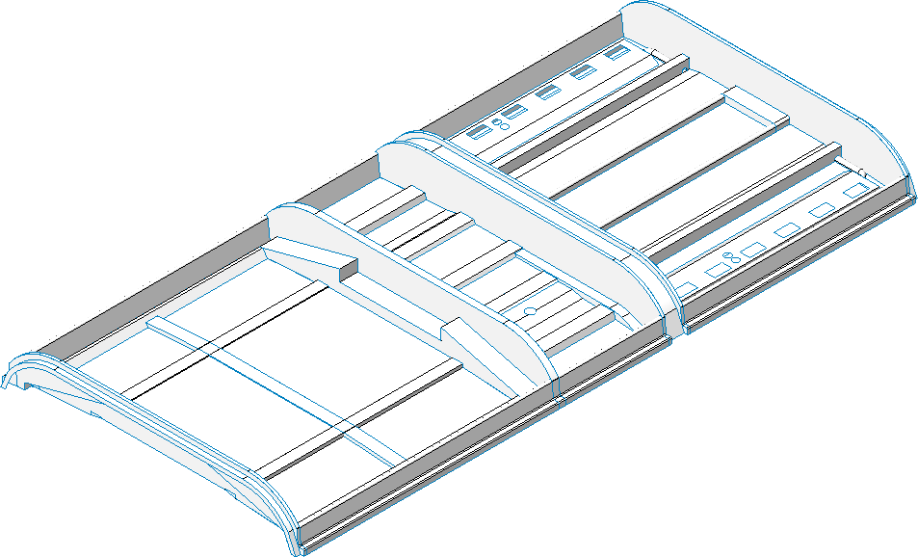
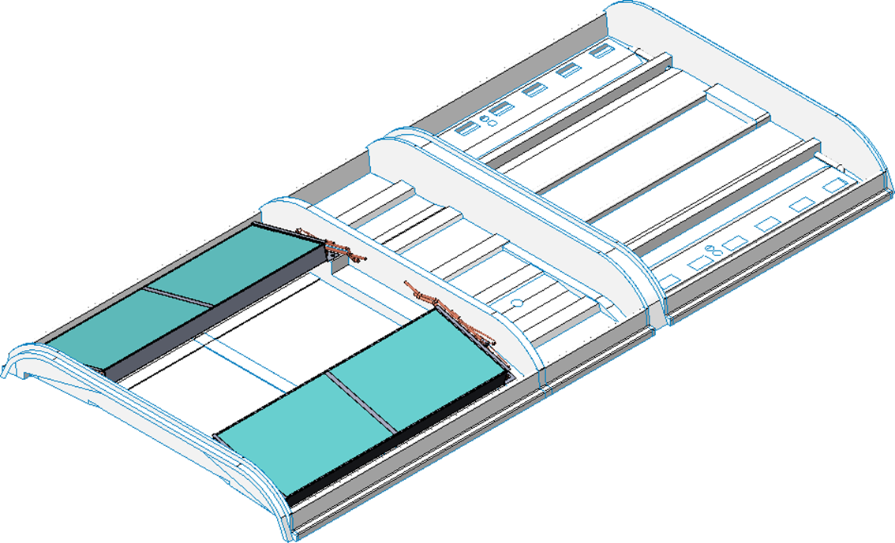
EL 538 with Bock Compressor
FRP base
Assemble condenser coil on base.

Slide 2
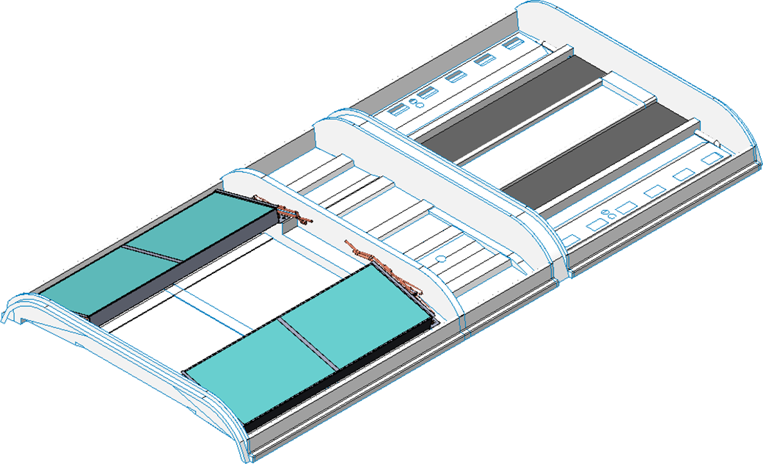
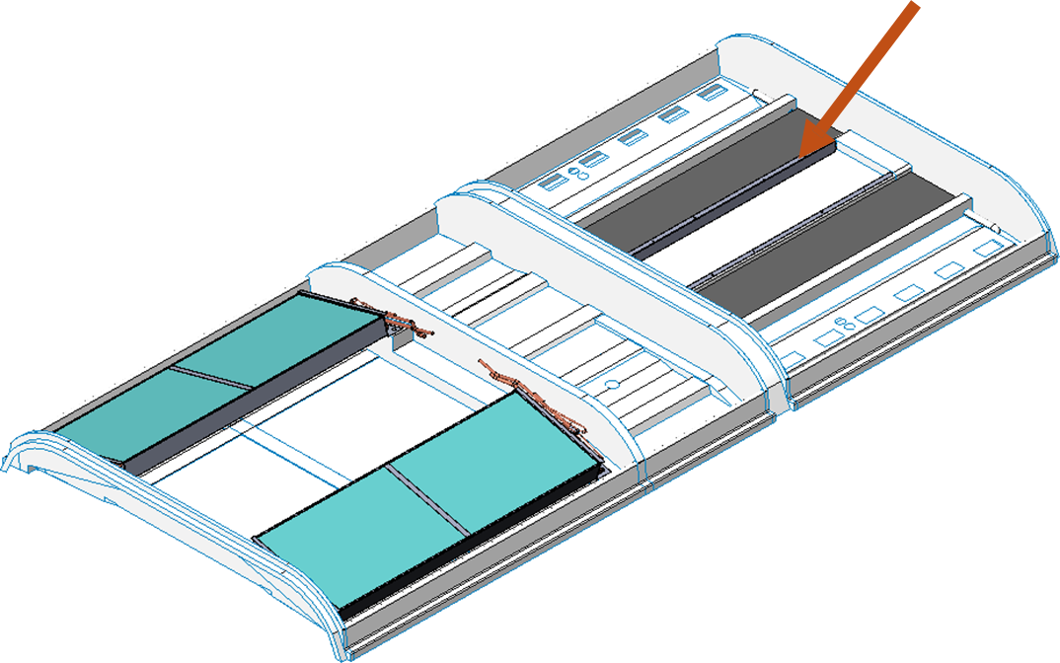
EL 538 with Bock Compressor
Apply SR-998 on base and add 10mm filter matt for evaporator coil.
Assembly :Return air side brackets with revit.

Slide 3
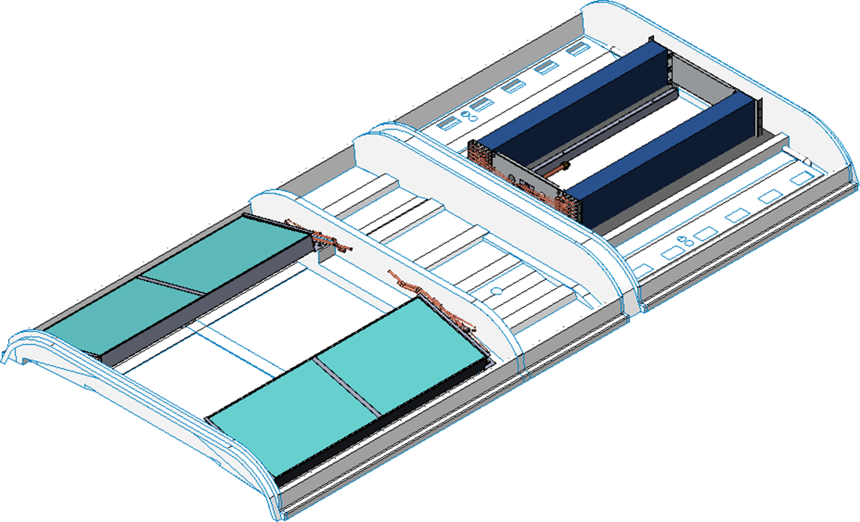
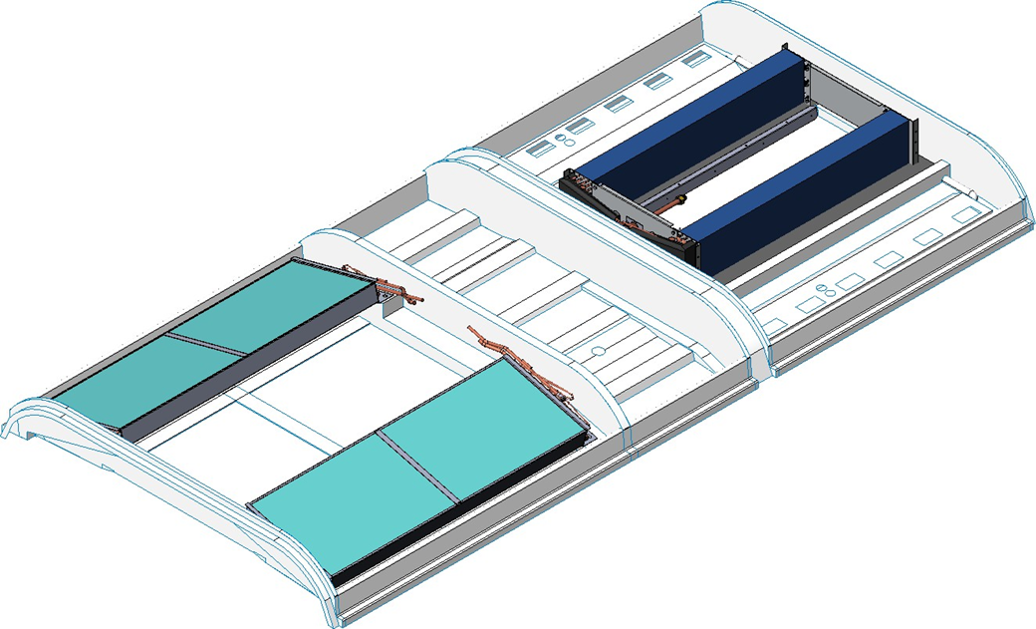
EL 538 with Bock Compressor
Assembly :Evaporator coil on base.
Evaporator coil insulation using 3mm foam.

Slide 4
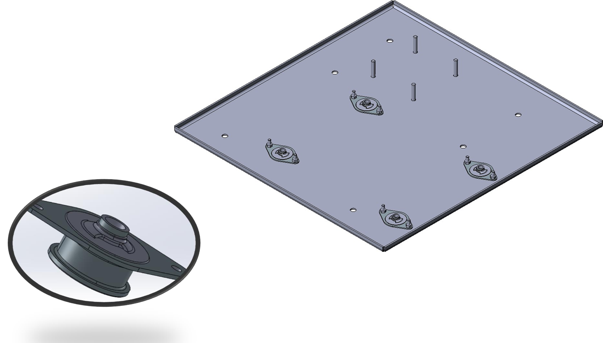
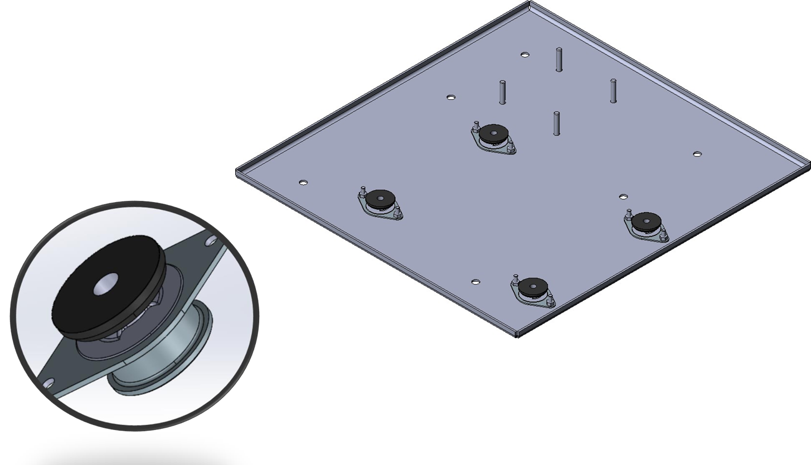
EL 538 with Bock Compressor
Mount vibration absorber plate on compressor mounting plate.
Plate vibration absorber washer on top of vibration absorber Plate.

Slide 5
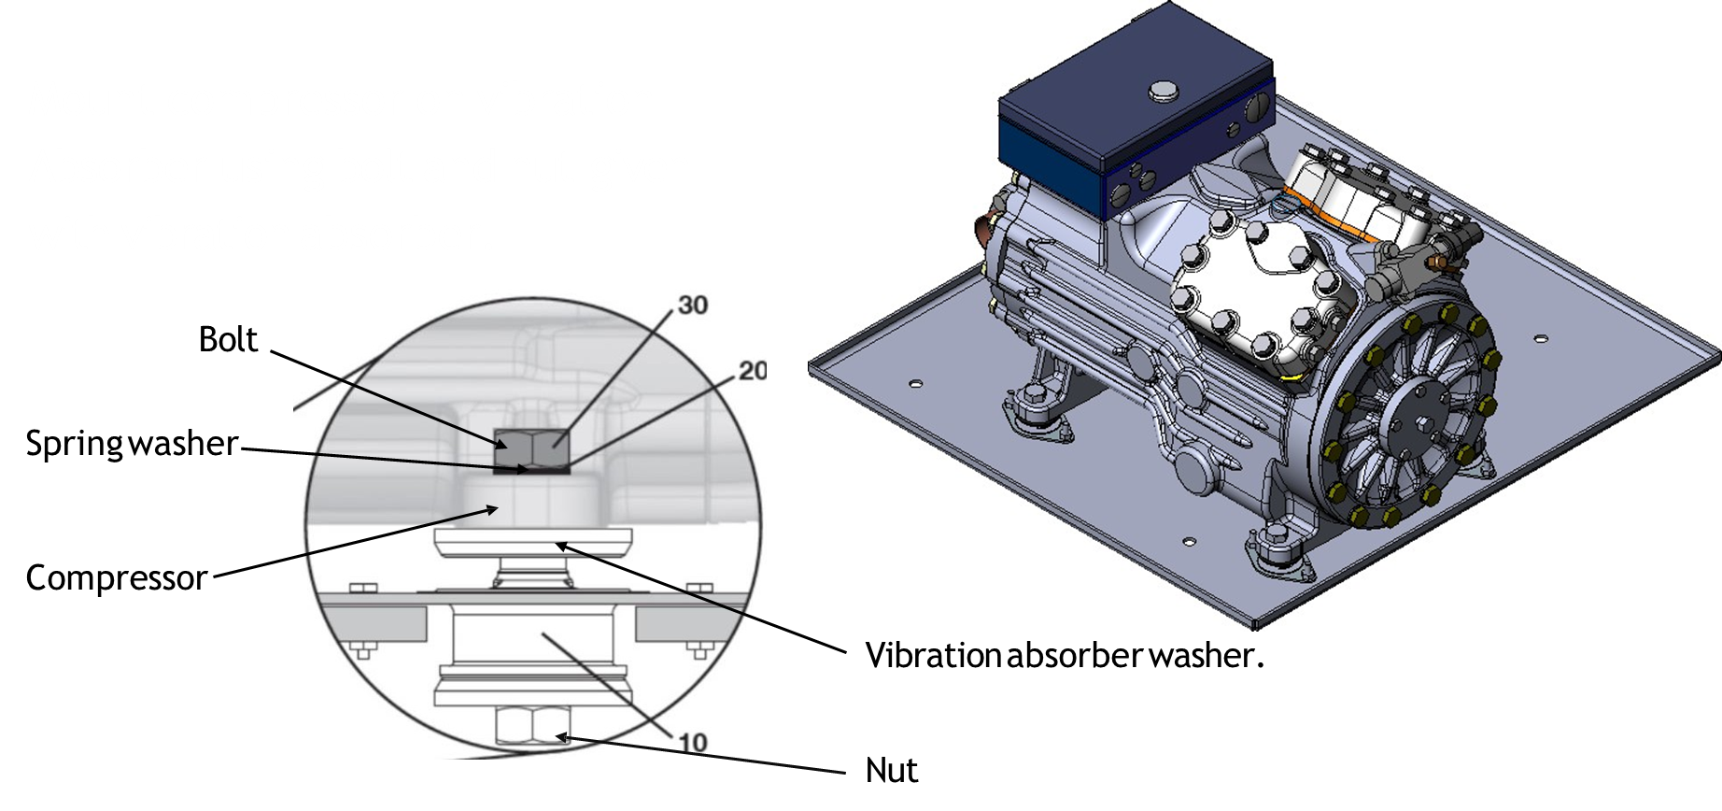
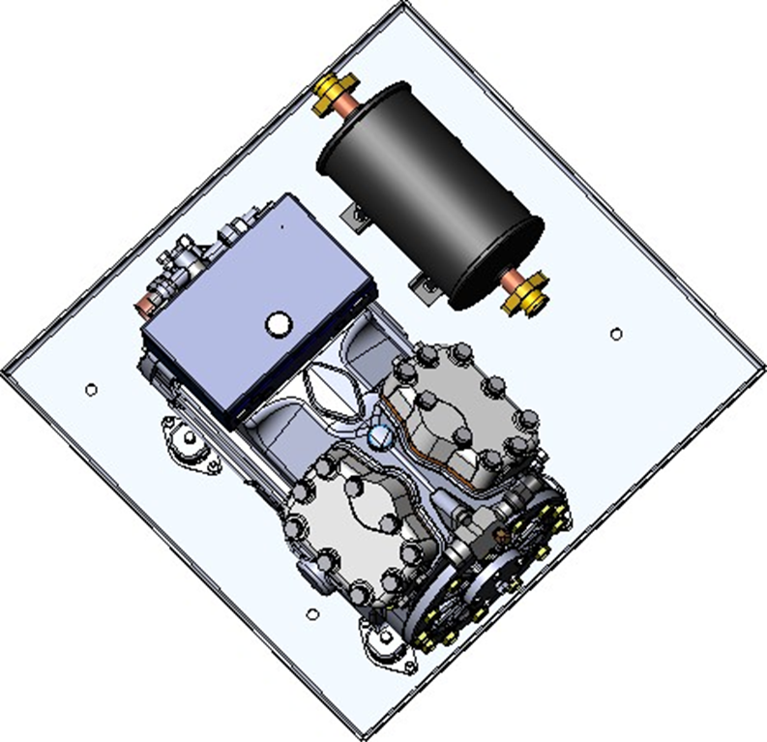
EL 538 with Bock Compressor
Mount compressor on vibration Absorber using bolt and nut given with vibration absorber.
Mount compressor accumulator on compressor mounting plate

Slide 6
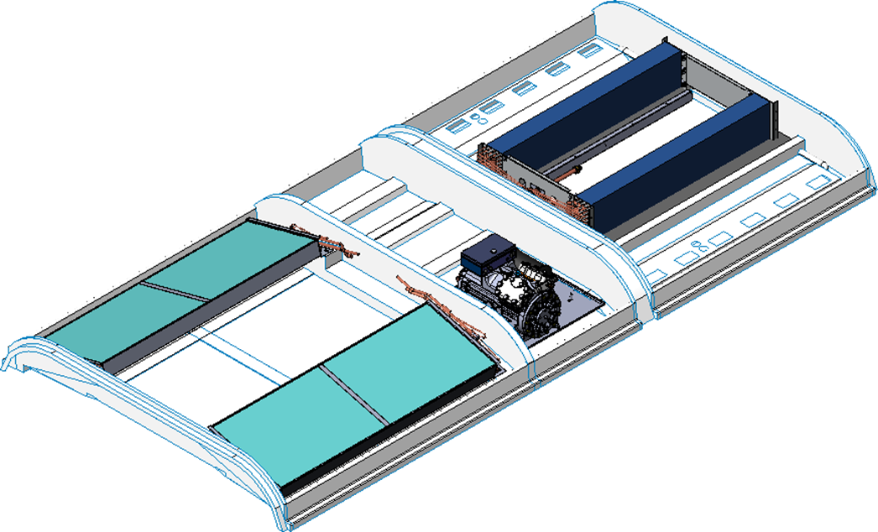

EL 538 with Bock Compressor
Mount compressor mounting plate on base.
Assemble txv with check valve assy. and liquid line assy.

Slide 7
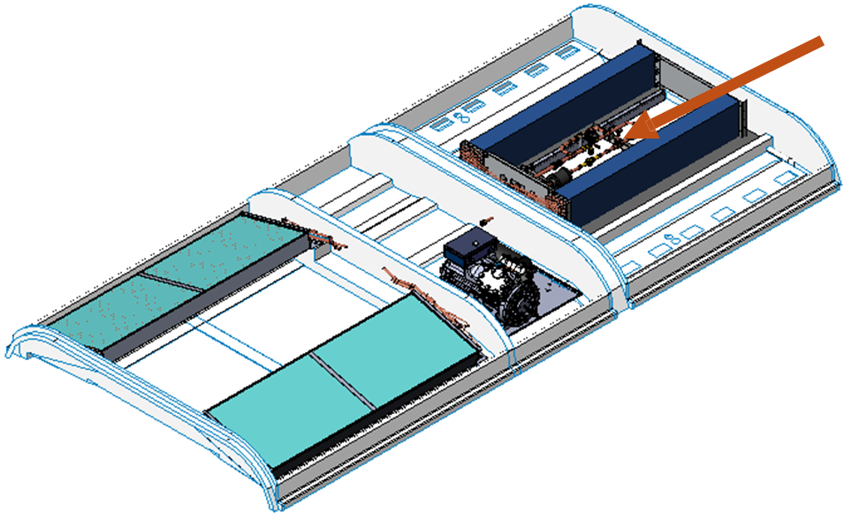
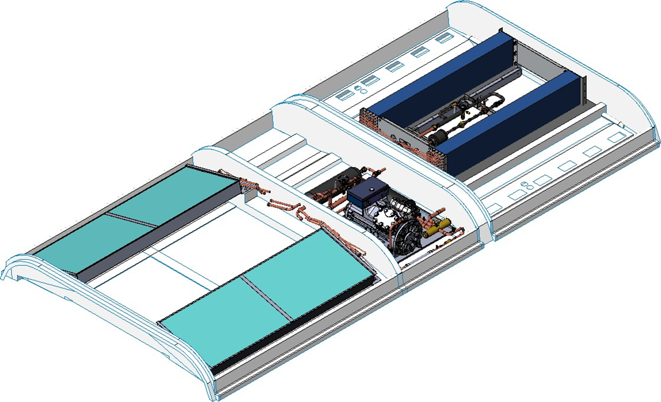
EL 538 with Bock Compressor
Evaporator side brackets Assembly
Insulation liquid line including TXV and bond tape.

Slide 8
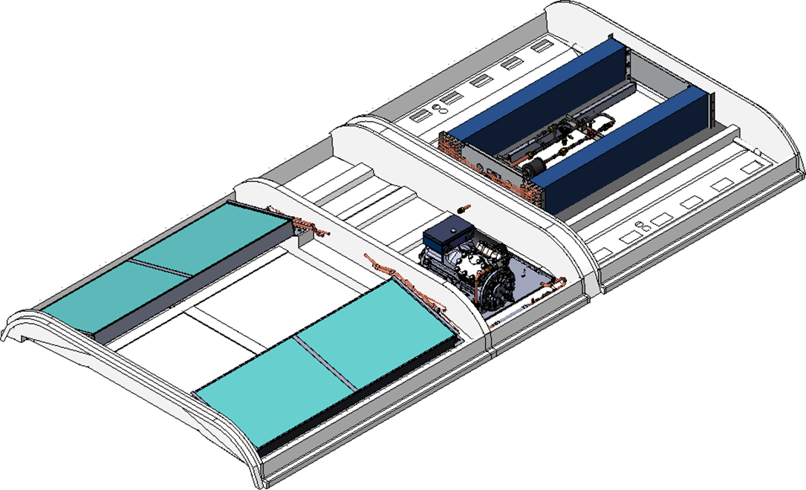
EL 538 with Bock Compressor
Assembly equalizer line for txv.
Compressor Discharge Tube Assembly

Slide 9
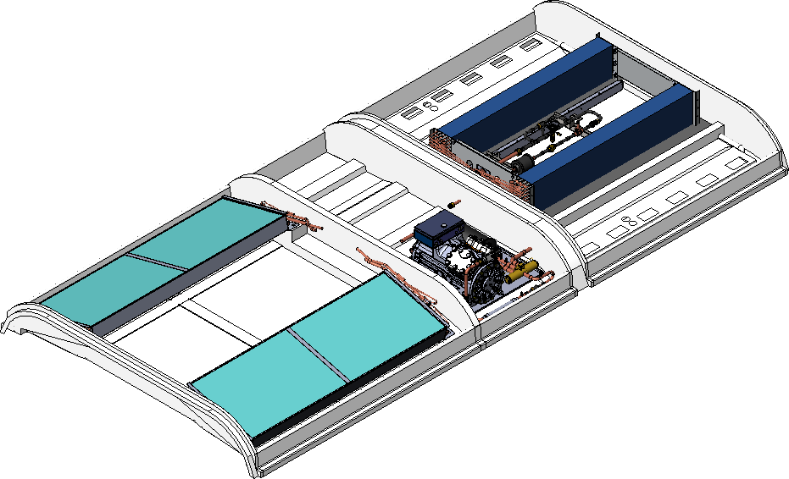

EL 538 with Bock Compressor
Braze revarse valve with discharge C suction from evaporator.
Assemble accumulator with reverse valve assembly.

Slide 10


EL 538 with Bock Compressor
Assemble condenser in / out line tubes.
Install exhaust fan with plate.

Slide 11
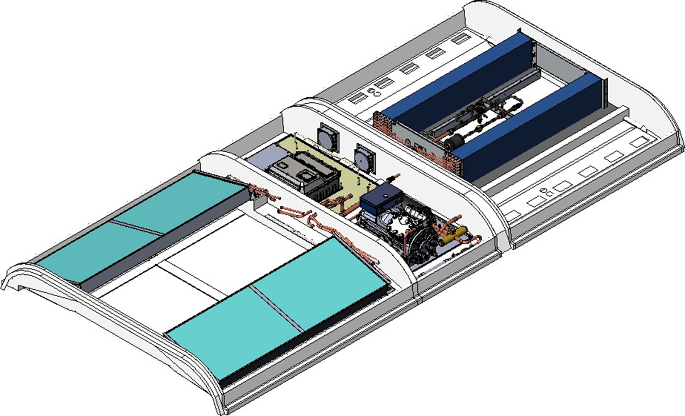

EL 538 with Bock Compressor
Assemble invertor plate with assembly.
Assemble receiver tank on invertor plate.

Slide 12


EL 538 with Bock Compressor
AssemblY condenser side equalizer line for txv.
Condenser side TXV bulb mount on discharge line and insulate with 3mm foam.

Slide 13
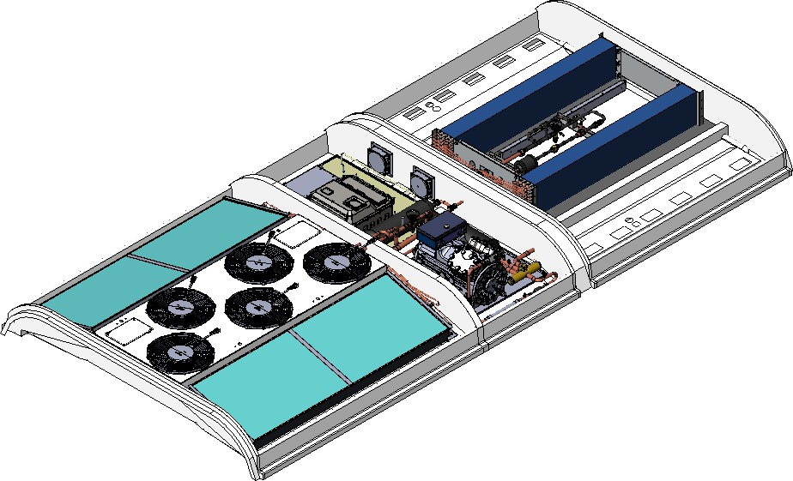
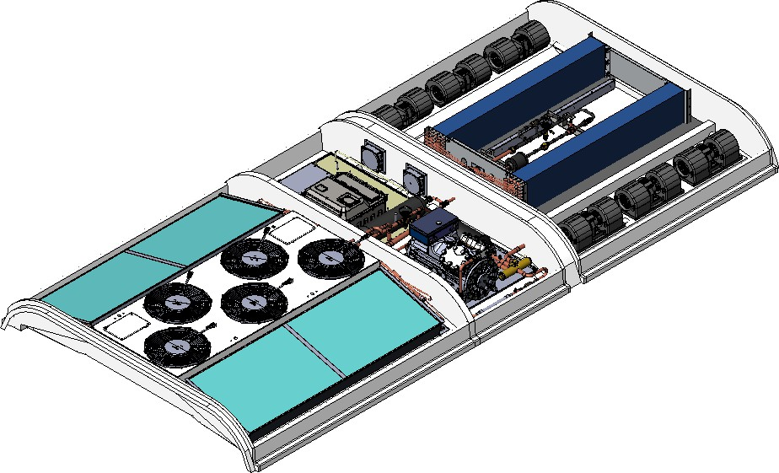
EL 538 with Bock Compressor
Mount condenser fan shrouds.
Add 3mm blower foam and install blower with self taping screw.

Slide 14
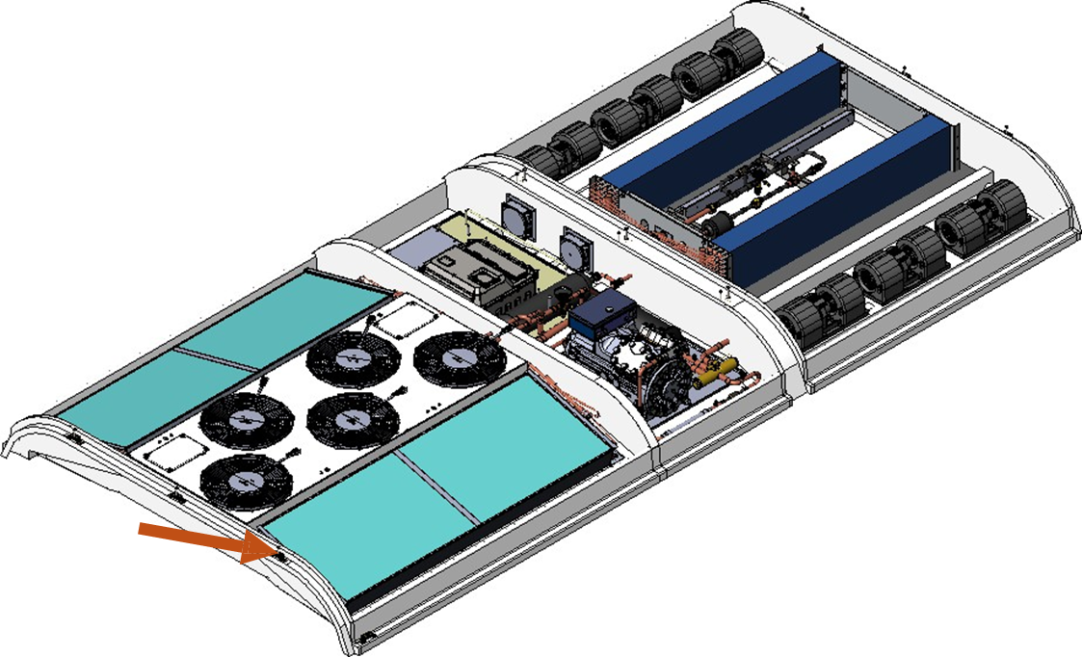
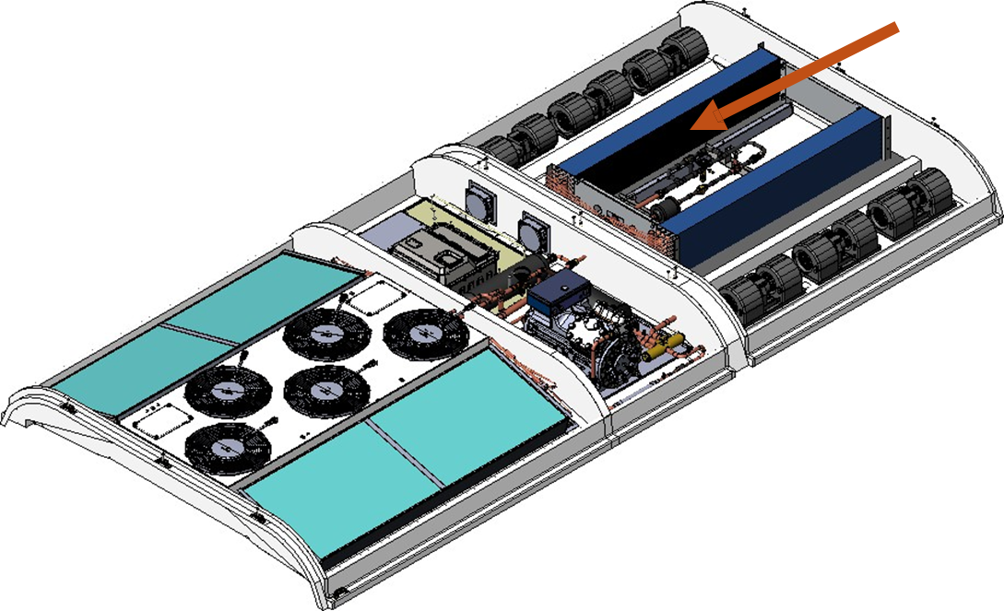
EL 538 with Bock Compressor
Adjustable mounting brackets with self taping screw and add with pv seclent on screw.
Add 20mm return air filter using pvc foam.

Slide 15

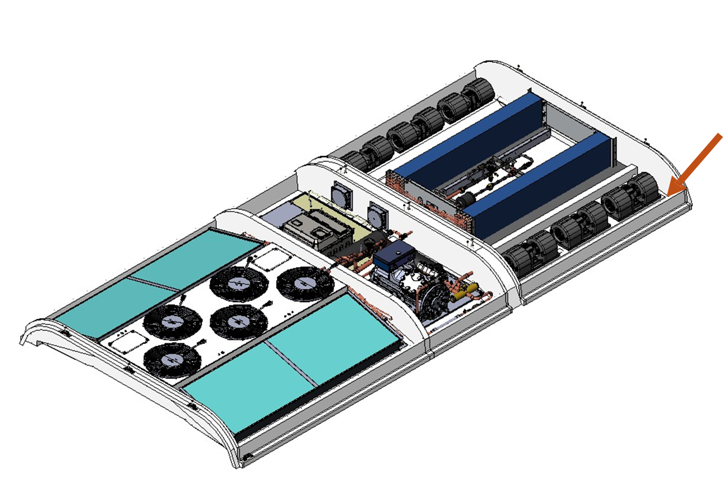
EL 538 with Bock Compressor
Add wiring routings and grommet in holes.
Install lifting hooks using m-12 nut.

Slide 16


EL 538 with Bock Compressor
−Seal all the gaps between condenser coil and base , cond. Coil and fan shroud using foam and sealant.
−Seal all the gaps in grommets using sealant.
Install 13mm foam under evaporator cover using SR-998.

Slide 17
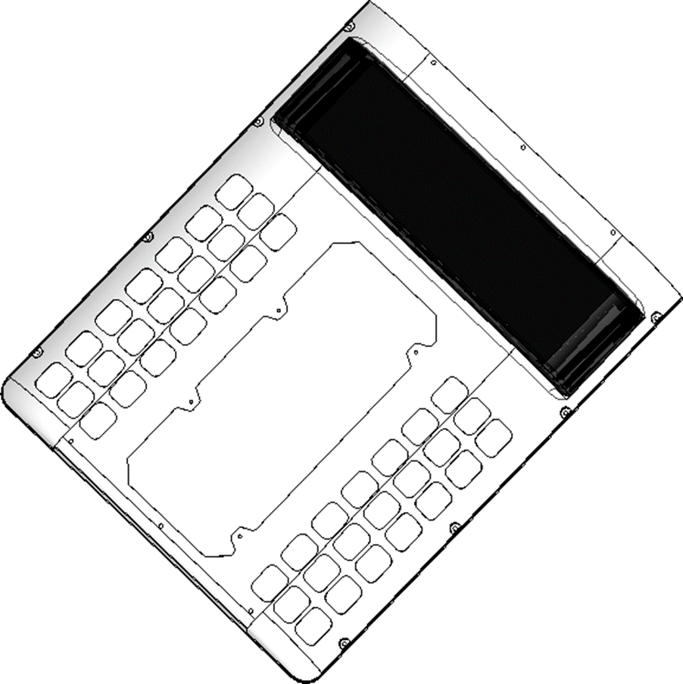
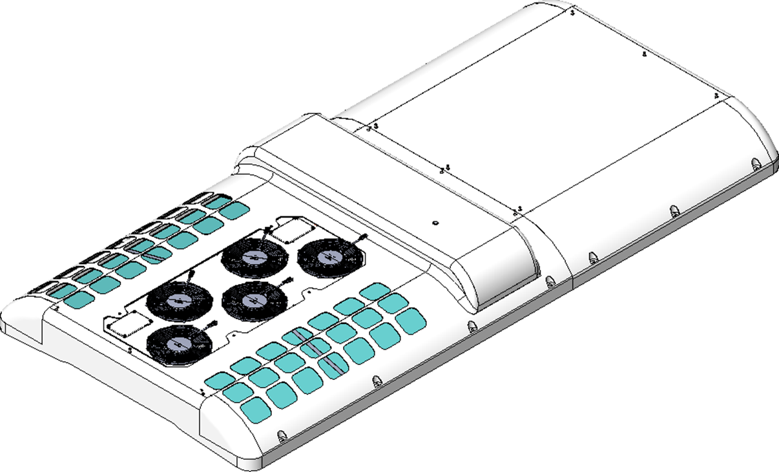
EL 538 with Bock Compressor
Add 13mm foam invertor side using SR-998.
Mount evaporator and condenser top cover.

